Slide 1





GSEP / EHD Alignment - Draft Capability Roadmap
This is trying to show different elements specific to EHD across the entire AI landscape.
2025
Future
Ask Boeing Live Agent Handoff
Full Rollout &
OCM
AI Guided Incident Creation
Proactive Communication
Ask Boeing
AI Agent for Incident Triage (POC)
Now Assist
Summarization
AI Based Incident
Triage / Routing
Now Assist
Resolution
Now Assist
Communication Recommendations
Now
Assist
Agent Workspace Retirement
Appointment
Scheduling
Adoption of
Now Assist Skills
Service Operations Workspace
SOW Baseline
Config
AI Search KB Meta Data tuning
Persona focused
Tagging
Now Assist KB authoring support
Automated Knowledge Block Management
Knowledge
Management
AI Search Implementation
Platform Analytics
Enablement
Platform Analytics
EHD Dashboard
AI enabled
Trend Analytics
AI Recommendation
Analytics
Analytics
Completed
In Work
Proposed

Slide 2
Roadmap – Draft
Phase 1: UX Quick Wins (AI-Driven User Experience)
Ask Boeing Growth and integration
Enable AI-powered search for end user service catalog, incident and knowledge base.
Phase 2: Generative AI & Automation
Automate fulfillment of routine service catalog items initiated via AI chat.
Streamline service catalog forms with AI-driven autocomplete and suggestions.
Use predictive analytics for change risk assessment and release impact forecasting.
Phase 3: Generative AI & Knowledge Empowerment
Auto-generate and keep up-to-date knowledge articles for incidents, changes, and catalog items.
Phase 4: Agentic AI & Autonomous Operations
Enable AI-powered search of MIM data including status and Summary
Enable Chatbot Approvals for RITM
Fulfiller AI enablement for task and CI summarization
Automate approvals for low-risk catalog and change requests based on AI recommendations.
AI-driven recommendations during change planning and release scheduling.
Use AI to identify knowledge gaps affecting catalog and incident workflows.
AI agents autonomously manage incident resolution, change execution, and catalog orders including approvals.
Integrate AI-driven orchestration for multi-step release processes.
Very initial roadmap. Based in part on Gartner AI material.
Phase 2-4 are Notional. Will be based updated based on Alignment and Advisory Discussions

Slide 3
Phase One - Ask Boeing Growth
Details of Phase 1
Ask Boeing Current State
Ask Boeing will be End User facing Conversational Interface
75%+ of use to date is through MS Teams
End User IT Knowledge in Production
HR Knowledge is in work
Ask Boeing Growth enabled through SN
Work to “Tune” AskBoeing Responses
Exposing more meta data for KB and Catalog
Personalization of responses through user attributes
Expand to Major Incident Use Cases
“Are there any open MIM”
“How many MIM’s were there last month / yesterday / last week”
Is there a MIM impacting BCA / 787 / St. Louis / Charleston / F-18

Slide 4
Phase One– Ask Boeing Integration
Details of Phase 1
Ask Boeing Integration
Build Bot to Bot integration
For “Actions” fulfilled through SN, expose through Virtual Agent / Now Assist integration
Leverage Native SN functionality and business logic as much as possible
Ask Boeing Integration Use Cases
RITM Approvals
Notifications in Moveworks
Summary of Approvals
Approval Button
Live Agent Integration and Handoff
Live agent through Moveworks UI / Teams
Live agent summary for handoff

Slide 5
Phase One – Now Assist ITSM
Details of Phase 1
Now Assist ITSM deployment
Enable the foundation for Now Assist within GSEP
Fulfiller focused Use Cases
Now Assist Use Cases
Now Assist Configuration
Foundational Setup
Now Assist Global Panel
Now Assist Virtual Agent integration
Now Assist CI Summarization
Server
Business Application
Now Assist ITSM record summarization
Incident
Change

Slide 6
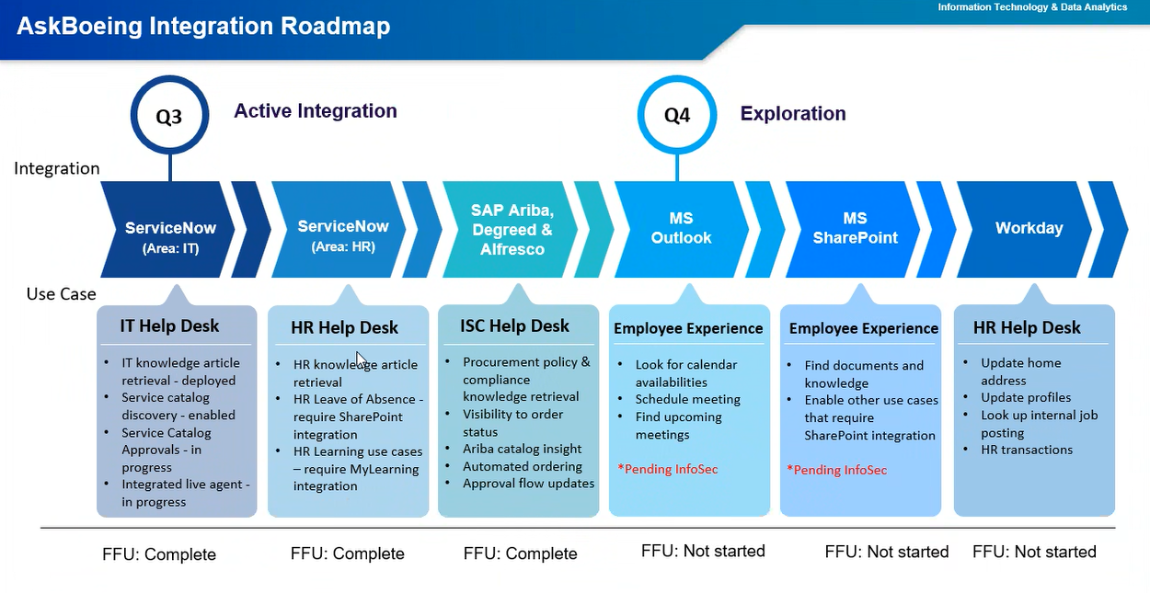
Ask Boeing Roadmap
AskBoeing Notional roadmap from 3Q 2025. I do not have a more recent version of this

Slide 7




ServiceNow AI/Hyper-Automation Maturity Journey
Stage 4
Hyper-Automation
AI Maturity Journey is a Business-driven ServiceNow recommended AI adoption path for incremental value creation across all workflows and all AI capabilities of ServiceNow.
Achieve Operational Excellence/Intelligence
Performance tracking
Integrate Service & Operations management
Auto-resolve major issues
Stage 3
Automation
Roadmap provided by ServiceNow Impact team as part of AI readiness Assessment
Stage 2
Generative AI
Scale Automation
Automate/Optimize mundane operations including 3rd party workflows
AI capabilities for enhancing productivity across workflows
Stage 1
AI Inception
Stage 0
Foundation
Move from conversation to resolution
Automate knowledge management
Integrate AI with automation capabilities
Self-solve/serve
Accelerate workflows with Introduction to AI
Boost productivity
Standardized knowledge management
Prescribed usage of ServiceNow workflows
Prescribed data volume and quality
Automation Center
AI Ops: Health Log analytics
Skills Intelligence
AI Ops: Metric Intelligence
AI Search
Now Assist for Search
Document Intelligence
Predictive AI Ops
Virtual Agent
Now Assist for Agent
Portal (Emp Ctr or Svc Prtl)
Issue Auto Resolution*
Predictive Intelligence
*Not in Vancouver GA, but in Innovation Lab Release
Knowledge Management
Now Assist for Flow
Process Mining
Task Intelligence
Now Assist for Creator
Workspaces
Automation Discovery
Workforce Optimization
Generative AI Controller
RPA Hub
Personas benefitted
Employee/Customer
Agent
Process Owner/Admin
Developer/Product Manager
Multiple personas
Process Automation Designer
UX & Performance Analytics
Flow Designer, App Engine
Multi-lingual NLU & NLQ
and Dynamic Translation
Integration Hub
You may choose to fast track Now Assist to realize the quick-start GenAI capabilities.
This readiness assessment may help you to decide.
Automated Test Framework
*Issue Auto Resolution
VA with either ITSM or HR and KB/Catalog
Notes:
NOTES:
We recommend a progressive approach to implementing your ServiceNow AI capabilities
Stage 0:
Establish a strong foundation by:
Establish the Portal experience for your end users
Service Portal
Employee Center
Establishing your Knowledge Base and Service Catalog
If you have an established Knowledge Base you’ll want to ensure the quality of the articles as well as remove stale articles.
Establish Workspace experience for your Agents.
Establish ticket handling processes and workflows for your agents that include searching for solutions in the Knowledge Base
Establish strong foundation of Users records that will be the basis for your user directory and People search.
Stage 1: Establish AI base camp
Install and configure Virtual Agent
Install and configure AI Search
Issue Resolution
*** Virtual Agent is pre-requisite
How Issue Auto Resolution works (ITSM, HR)
When a user creates an issue,
The Issue Auto Resolution application uses machine learning and NLU to identify the criticality of the issue, the intent, and an appropriate Virtual Agent Topic for an automatic resolution.
If a Virtual Agent topic isn’t found, Issue Auto Resolution does an AI Search to return the most appropriate Knowledge articles, FAQs, or catalog content.
The deflection content is then delivered to the user through the configured response channel, such as the Virtual Agent, email or short messaging service (SMS).
Stage 2: Establish Generative AI foothold
There are several Gen AI capabilities that are immediately available:
Now Assist for Search
Genius Results
Now Assist for Agent – refer to each product for its specific features
Now Assist for Agent - ITSM includes, for example:
Chat summarization
Incident Notes Summarization
Generate Resolution Notes for Incident

Slide 8
Ask Boeing and GSEP Integration Architecture
Phased Architecture Roadmap
ServiceNow
Ask Boeing (Moveworks)
Other Boeing Systems
SN Data
KB
INC, RITM,
Cat Item
User
AI Search
Moveworks indexed Data
Catalog Items
Data
Now Assist
ITSM Now Assist Skills
Moveworks Plugin’s
LLM
Virtual Agent
CMDB Now Assist Skills
LLM
Ask Boeing
Custom Agents
SN Live Agent
SN Virtual Agent API
Agent Integration
BCAI
Chat
Fulfiller Channels
End User Channels
LLM
Workspace
Classic UI
Now Assist
GSEP Portal
My Boeing
Teams
In Production
In Development
POC Evaluation

